Slide 1
Unit-1

Slide 2
Boolean Algebra

Slide 3
Boolean Algebra vs Ordinary algebra
Boolean Algebra : A British Mathematician George Boole introduced algebra of binary numbers in 1854. This is known as Boolean algebra. Boolean algebra is used in designing of logical circuits inside the computer. These circuits perform different types of logical operations. Thus Boolean algebra is also known as logical algebra or switching algebra.
The mathematical expressions of Boolean algebra are called Boolean expression. Boolean algebra describes the Boolean expression used in logical circuits. The Boolean expressions are simplified by means of basic theorems. The expressions that describe the logical circuits are also simplified by using Boolean algebra.

Slide 4
Boolean algebra differs from ordinary algebra in the different ways.
Boolean algebra deals with binary numbers (0 and 1) while the high school algebra deals mainly with real numbers, Boolean algebra deals with the values 0 and 1. These can be thought of as two integers, or as the truth values false and true respectively. In either case they are called bits or binary digits, in contrast to the decimal digits 0 through 9.
Boolean algebra has only two basic operations cross, dot and complement operator , namely the Boolean operations OR, AND, and NOT respectively
There are no subtraction and division. Ordinary algebra performs all arithmetic operations such as plus, minus, multiplication, division, subtraction etc. ordinary algebra does not have complement operation.
Distributed law of Boolean algebra (a + (b . c) = (a + b). (a + c)) does not hold good in ordinary algebra. Boolean algebra perform only two basic operations which are called Boolean operators.
Boolean algebra also deals with other values on which Boolean operations can be defined, such as sets or sequences of bits.

Slide 5
Boolean Constant & Operators
Every logical statement or expression has a definite value which is either of the logical constants TRUE(1) or FALSE(0) but not both.
Boolean Algebra has logical operators which are used to form logical expressions using the operands, i.e., logical variables and logical constants (0 & 1). The logical or Boolean operators are: NOT, AND & OR.
For e.g. A OR (A AND B) = A
Denoted as A + (A . B) = A

Slide 6
DIGITAL COMPUTERS
Imply that the computer deals with digital information
Digital information: is represented by binary digits (0 and 1)
Gate
Binary digital input signal
GATE
Binary digital output signal
Gates – blocks of Hardware that produce 1 or 0 when input logic requirements are satisfied.
Functions of gates can be described by:
Truth Table
Boolean Function

Slide 7
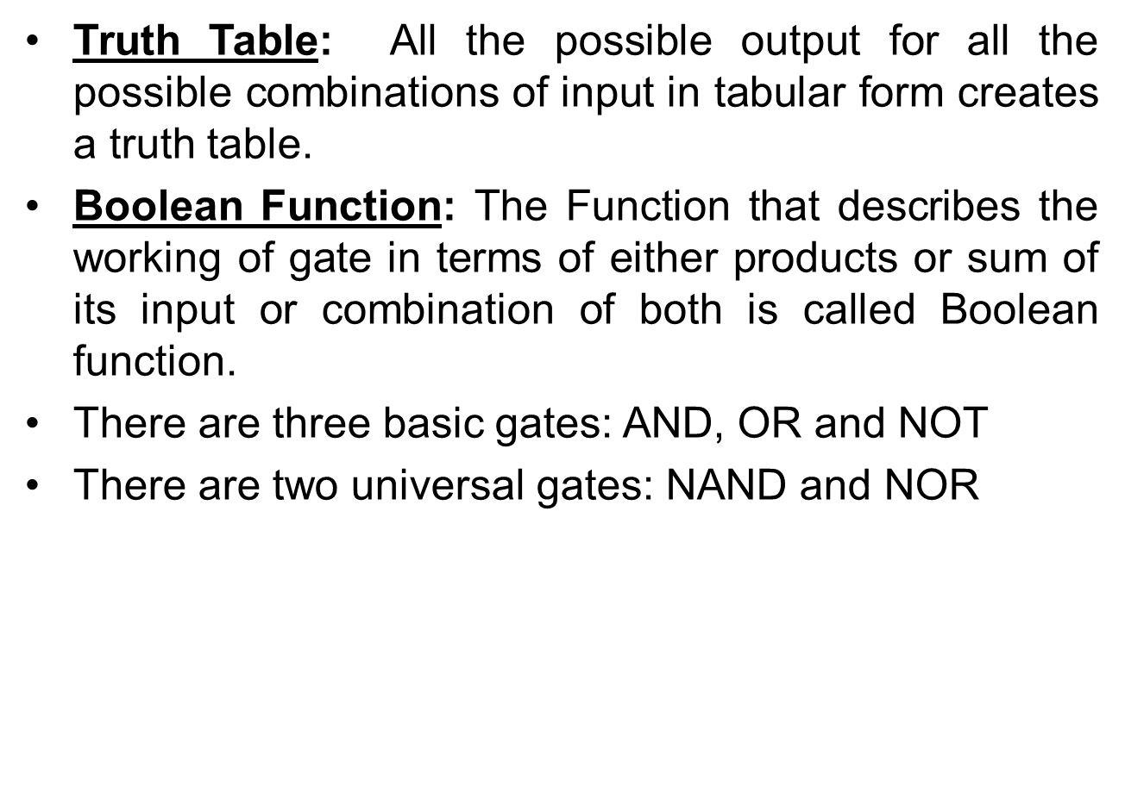

Slide 8
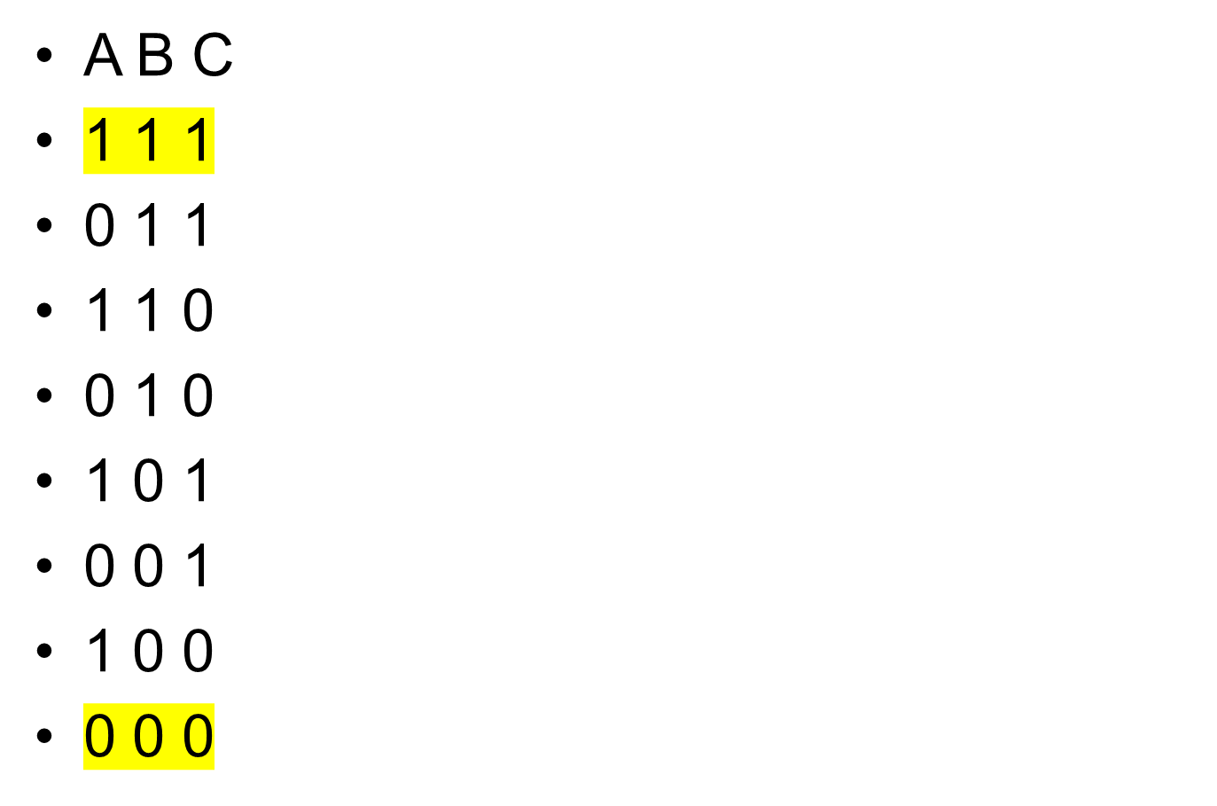

Slide 9
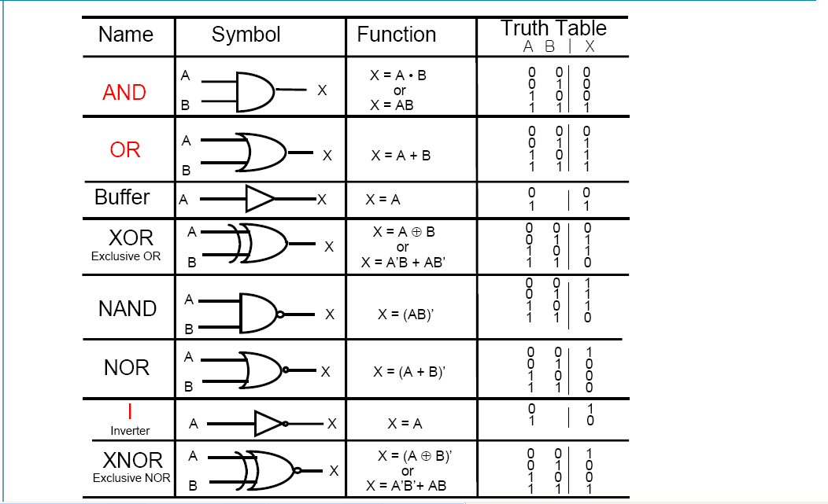

Slide 10
Fundamental Postulates of Boolean Algebra
X = 1 or 0
1.1=1
1.0 = 0.1 =0
0.0 = 0
0 + 0 = 0
1+0 = 0+1 = 1
1 +1 = 1
1 = 0
0 = 1

Slide 11
Theorems of Boolean Algebra
Complementation Law
X . X = 0
X + X = 1

Slide 12


Commutative Law
x + y = y + x [3+4 = 4+3]
x·y = y·x [8x9 = 9x8]
In Boolean algebra:
A+B = B+A
A.B=B.A

Slide 13


Associative Law
(x+y) + z = x+(y+z) [(3 + 4) + 5 = 3 + (4 + 5)]
(x·y) ·z = x·(y·z) [(8 x 9) x 6 = 8 x (9 x 6)]
In Boolean Algebra:
(A+B) + C= A+(B+C)
(A·B) ·C = A·(B·C)

Slide 14
Distributive Law
x(y+z) = xy + xz (multiplication can be distributed over addition)
x+(y•z) ≠ (x+y)• (x+z) (addition cannot be distributed over multiplication)
In Boolean algebra
A•(B+C) = (A•B) + (A•C) (AND can be distributed over OR)
A
B
C
B
A
C

Slide 15
A+(B•C) = (A+B) • (A+C) (OR can be distributed over AND)
C
A
C
B
B
A

Slide 16
DEMORGAN'S LAWS
AND and OR logic are related by DeMorgan's Laws
A•B = A+B (The complement of the product equals the sum of the complements)
A+B = A•B (The complement of the sum equals the product of the complements)
Rules of AND Rules of NAND
A•0 = 0 A NAND 0 = 1
A•1 = A A NAND 1 = A
A•A = A A NAND A = A
A•A = 0 A NAND A = 1
Rules of OR Rules of NOR
A+0 = A A NOR 0 = A
A+1 = 1 A NOR 1 = 0
A+A = A A NOR A = A
A+A = 1 A NOR A = 0

Slide 17
Verifying DeMorgan’s First Theorem using Truth Table
We can also show that A.B = A+B using logic gates as shown.
Inputs |  | Truth Table Outputs For Each Term
B | A | A.B | A.B | A | B | A + B
0 | 0 | 0 | 1 | 1 | 1 | 1
0 | 1 | 0 | 1 | 0 | 1 | 1
1 | 0 | 0 | 1 | 1 | 0 | 1
1 | 1 | 1 | 0 | 0 | 0 | 0

Slide 18
Rules of XOR Rules of XNOR
A⊕ 0 = A A XNOR 0 = A
A⊕1 = A A XNOR 1 = A
A⊕A = 0 A XNOR A = 1
A⊕A = 1 A XNOR A = 0

